Slide 1
International Institute of
Professional Studies, DAVV, INDORE
Presentation on:
“ INTRODUCTION TO DBMS”
Prepared and Presented by:
Mr.Naresh Dembla
Asst. Proff.,IIPS, DAVV, Indore
7-1-2012
Introduction

Slide 2
Introduction to DBMS
Purpose of Database Systems
View of Data
Data Models
Data Definition Language
Data Manipulation Language
Transaction Management
Storage Management
Database Administrator
Database Users
Overall System Structure
7-1-2012
Introduction

Slide 3
Database Management System (DMBS)
Collection of interrelated data
Set of programs to access the data
DMBS contains information about a particular enterprise
DBMS provides an environment that it both convenient and efficient to use
7-1-2012
Introduction

Slide 4
Purpose of Database Systems
Database management systems were developed to handle the following difficulties of typical file-processing systems supported by conventional operating systems:
Data redundancy and inconsistency
Difficulty in accessing data
Data isolation – multiple files and formats
Integrity problems
Atomicity of updates
Concurrent access by multiple users
Security problems
7-1-2012
Introduction

Slide 5
View of Data
An architecture for a database system
View level
View 1
View 2
…
View n
Logical
level
Physical
level
7-1-2012
Introduction

Slide 6
Levels of Abstraction
Physical level: describes how a record (e.g. customer) is stored.
Logical level: describes data stored in database, and the relationships among the data.
type customer = record
name: string;
street: string;
city: integer;
end;
View level: application programs hide details of data types. Views can also hide information (e.g. salary) for security purposes.
7-1-2012
Introduction

Slide 7
Instances and Schemas
Similar to types and variables in programming languages
Schema – the logical structure of the database (e.g., set of customers and accounts and the relationship between them)
Instance – the actual content of the database at a particular point in time
7-1-2012
Introduction

Slide 8
Data Independence
Ability to modify a schema definition in one level without affecting a schema definition in the other levels.
The interfaces between the various levels and components should be well defined so that changes in some parts do not seriously influence others.
Two levels of data independence
  Physical data independence
  Logical data independence
7-1-2012
Introduction

Slide 9
Data Models
A collection of tools for describing:
  Data
  Data relationships
  Data semantics
  Data constraints
Object-based logical models
  Entity-relationship model
  Object-oriented model
  Semantic model
  Functional model
Record-based logical models
  Relational model (e.g., SQL/DS, DB2)
  Network model
  Hierarchical model (e.g., IMS)
7-1-2012
Introduction

Slide 10
Entity-Relationship Model
Example of entity-relationship model
social-security
customer-street
account-number
customer-name
customer-city
balance
depositor
customer
account
7-1-2012
Introduction

Slide 11
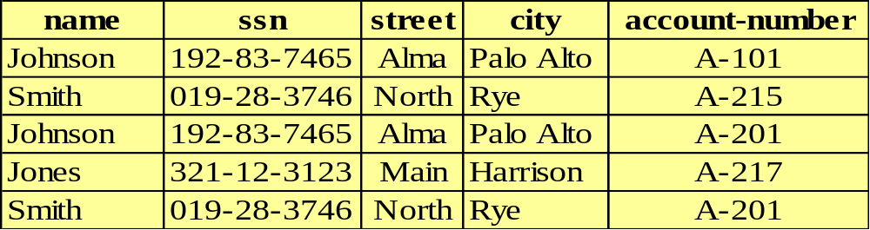
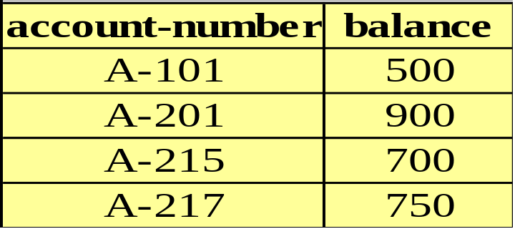
Relational Model
Example of tabular data in the relational model:
7-1-2012
Introduction

Slide 12
Data Definition Language (DDL)
Specification notation for defining the database schema
DDL compiler generates a set of tables stored in a data dictionary
Data dictionary contains metadata (data about data)
Data storage and definition language – special type of DDL in which the storage structure and access methods used by the database system are specified
7-1-2012
Introduction

Slide 13
Data Manipulation Language (DML)
Language for accessing and manipulating the data organized by the appropriate data model
Two classes of languages
  Procedural – user specifies what data is required and how to get those data
  Nonprocedural – user specifies what data is required without specifying how to get those data
7-1-2012
Introduction

Slide 14
Transaction Management
A transaction is a collection of operations that performs a single logical function in a database application.
Transaction-management component ensures that the database remains in a consistent (correct) state despite system failures (e.g. power failures and operating system crashes) and transaction failures.
Concurrency-control manager controls the interaction among the concurrent transactions, to ensure the consistency of the database.
7-1-2012
Introduction

Slide 15
Storage Management
A storage manager is a program module that provides the interface between the low-level data stored in the database and the application programs and queries submitted to the system.
The storage manager is responsible for the following tasks:
  Interaction with the file manager
  Efficient storing, retrieving, and updating of data
7-1-2012
Introduction

Slide 16
Database Administrator
Coordinates all the activities of the database system; the database administrator has a good understanding of the enterprise’s information resources and needs:
Database administrator’s duties include:
  Schema definition
  Storage structure and access method definition
  Schema and physical organization modification
  Granting user authority to access the database
  Specifying integrity constraints
  Acting as liaison with users
  Monitoring performance and responding to changes in requirements
7-1-2012
Introduction

Slide 17
Database Users
Users are differentiated by the way they expect to interact with the system.
Application programmers: interact with system through DML calls.
Specialized users: write specialized database applications that do not fit into the traditional data processing framework
Sophisticated users: form requests in a database query language.
Naive users: invoke one of the permanent application programs that have been written previously
7-1-2012
Introduction

Slide 18
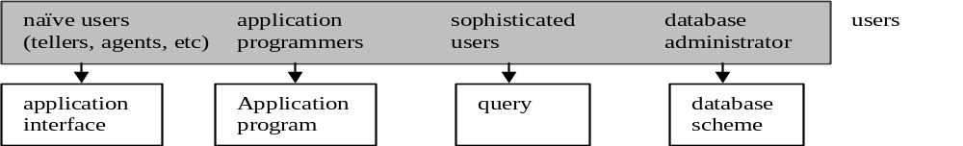
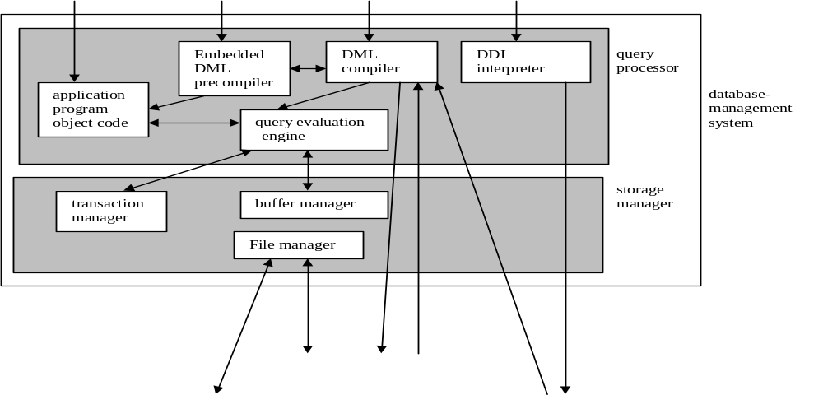
Overall System Structure
indices
Statistical data
disk storage
Data files
Data dictionary
7-1-2012
Introduction

